Slide 1
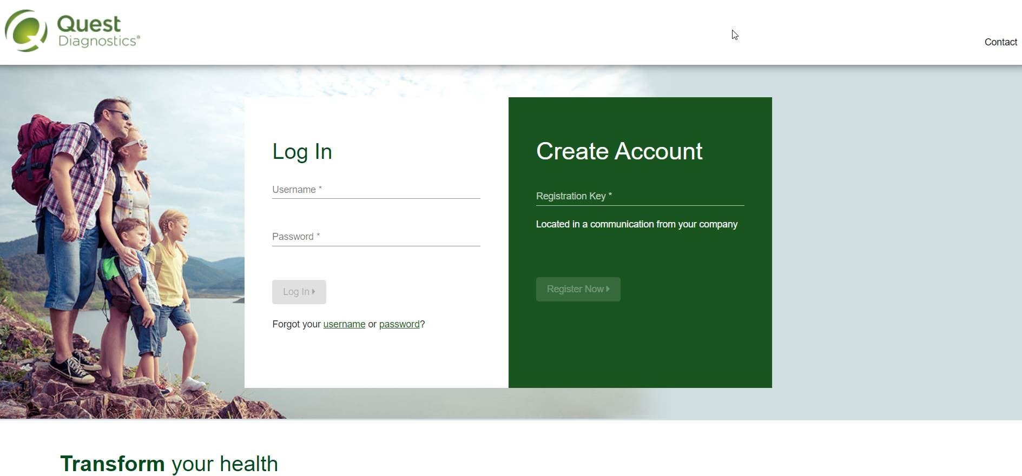
How to register on My.QuestForHealth.com
Visit My.QuestForHealth.com
If you’ve already established an account, use the Log In area to enter your username and password and select the green Log In button
If you’ve forgotten your login information, use the username link to retrieve your username or the password link to reset your password
If you’ve never registered on the site to establish an account, use the Create Account area, enter the registration key provided by your employer, and select the Register Now button
Please note: these screenshots are based on common browser resolution; actual screens may vary due to responsive design. If you are viewing on a tablet or smartphone, the images may look different.

Slide 2
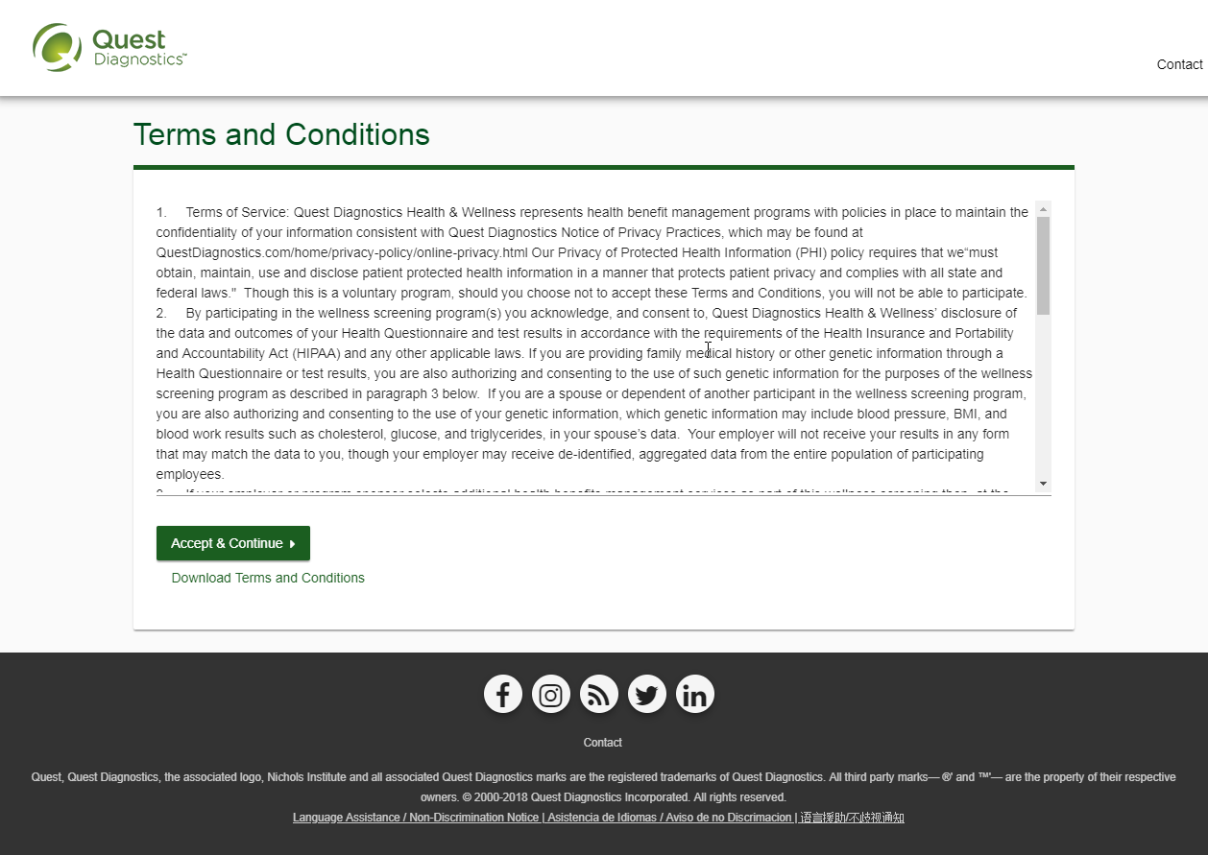
Read through the Quest Diagnostics Terms and Conditions
Scroll to the bottom and select the Accept & Continue button

Slide 3
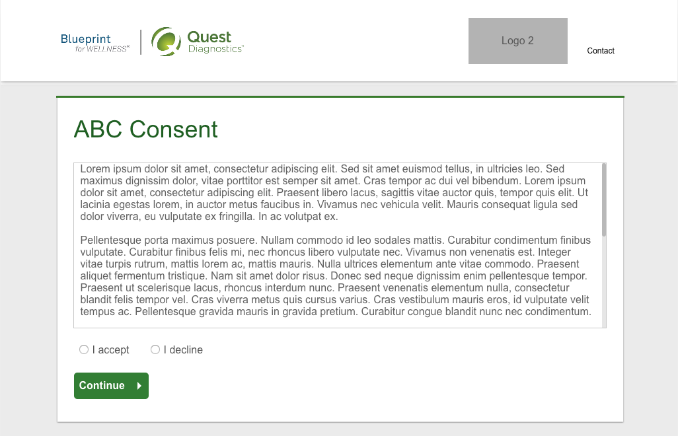
If custom consent is required for your program, you will need to read through the consent and select I accept
Then select the green Continue button

Slide 4
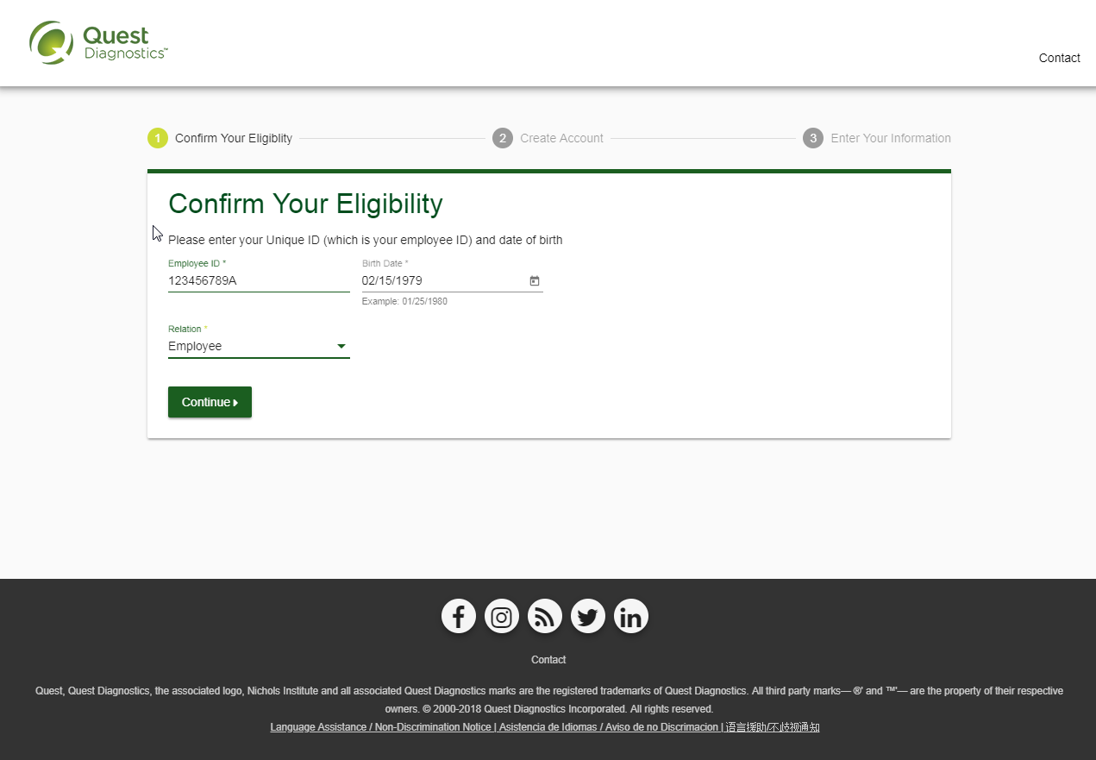
Under Confirm Your Eligibility, enter your Unique ID, Date of Birth, and relationship to the organization
Your Unique ID should have been provided to you in an employer communication
Your relationship should be either employee or spouse/domestic partner
Select the green Continue button

Slide 5
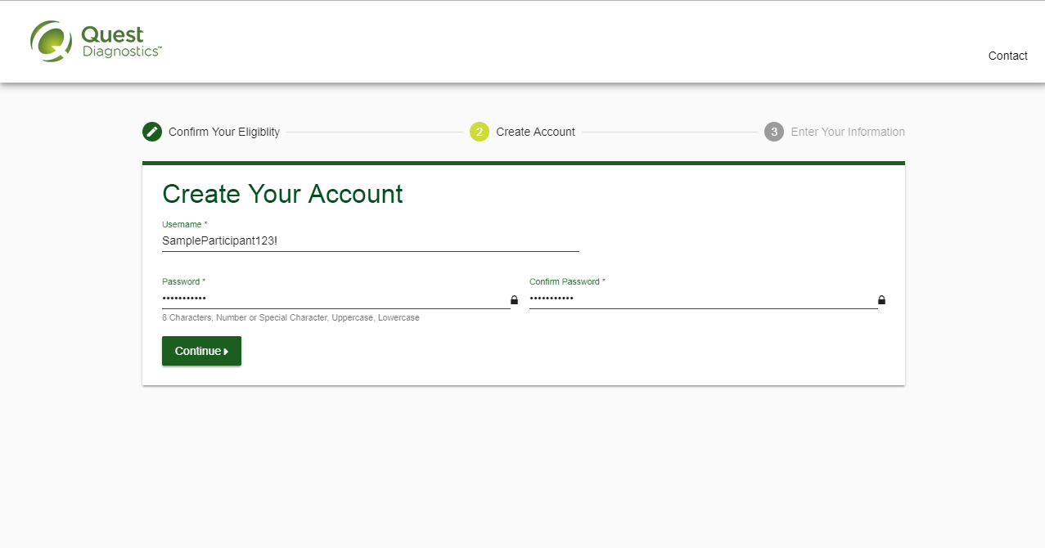
Create a username and password to log in to your account
The password must be at least 8 characters long, include a number or special character, and include at least 1 uppercase and 1 lowercase letter
Select the green Continue button

Slide 6
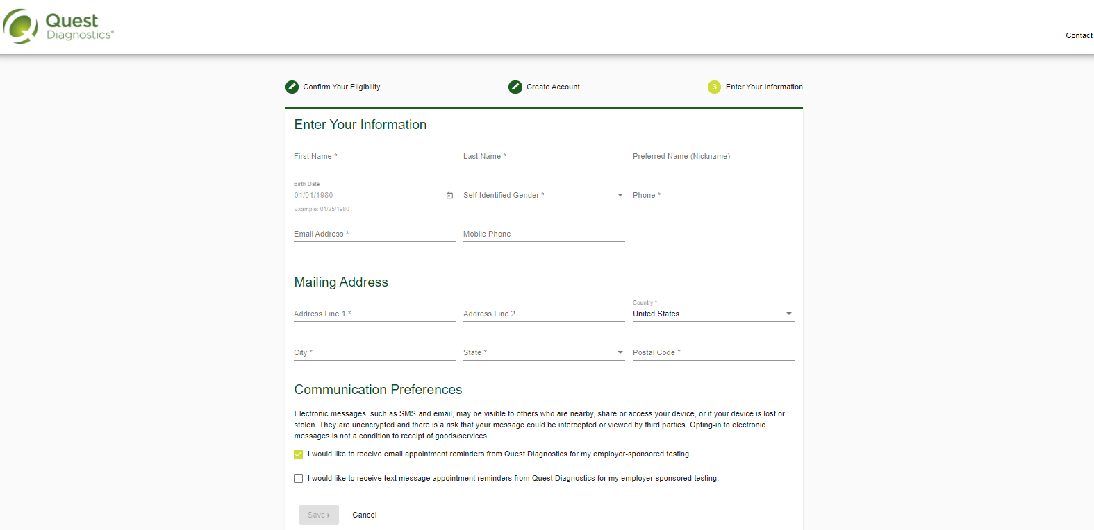
Verify/complete all of the information under Enter Your Information
Please note that an email address is required and will be used in case you need to retrieve your username or reset your password
Verify/complete all of the information under Mailing Address
Select if you would like to receive email or text message appointment reminders from Quest Diagnostics
If your employer has opted out of text messaging, your screen may look slightly different from the below
Select the green Save button

Slide 7
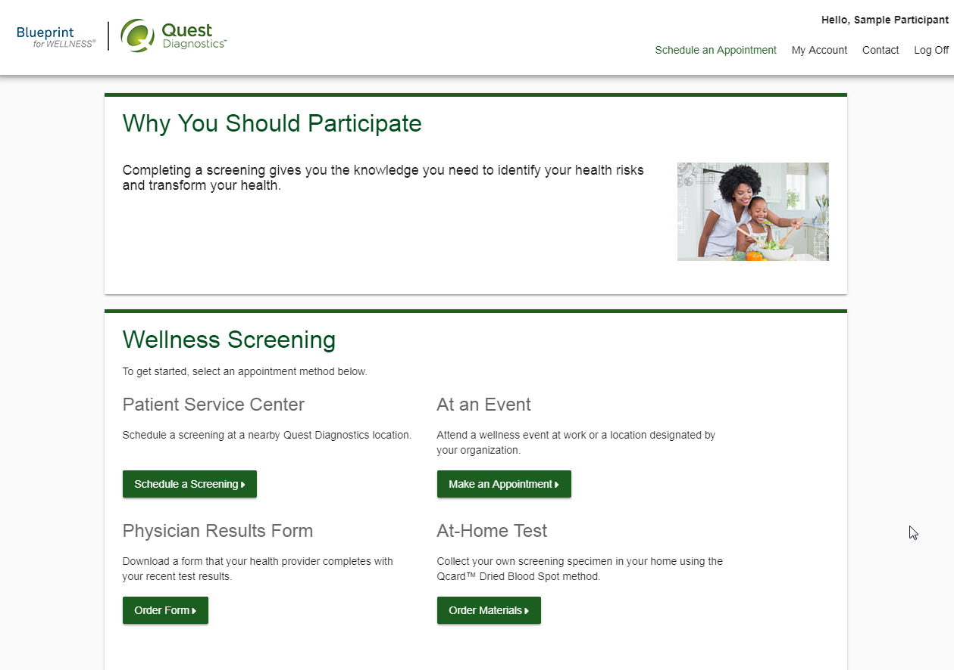
After registering, you will arrive at the dashboard
Under the Why you should participate section, you will see any program-specific information from your employer, if applicable

Slide 8
How to schedule a screening at a Quest Diagnostics Patient Service Center (PSC)
Visit My.QuestForHealth.com
If you’ve already established an account, use the Log In area to enter your username and password and select the green Log In button
If you’ve forgotten your login information, use the password link to reset your password or the username link to retrieve your username
If you’ve never registered on the site to establish an account, use the Create Account area
After logging in or registering, you will be taken to the dashboard
Please note: these screenshots are based on common browser resolution; actual screens may vary due to responsive design. If you are viewing on a tablet or smartphone, the images may look different.

Slide 9
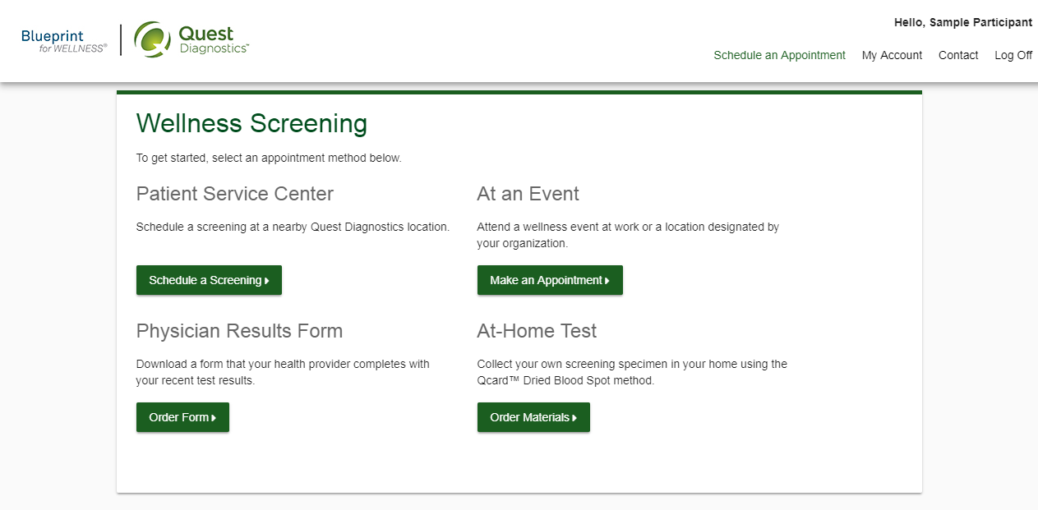
To schedule a screening at a PSC, in the Wellness Screening section, under Patient Service Center, select the green Schedule a Screening button

Slide 10
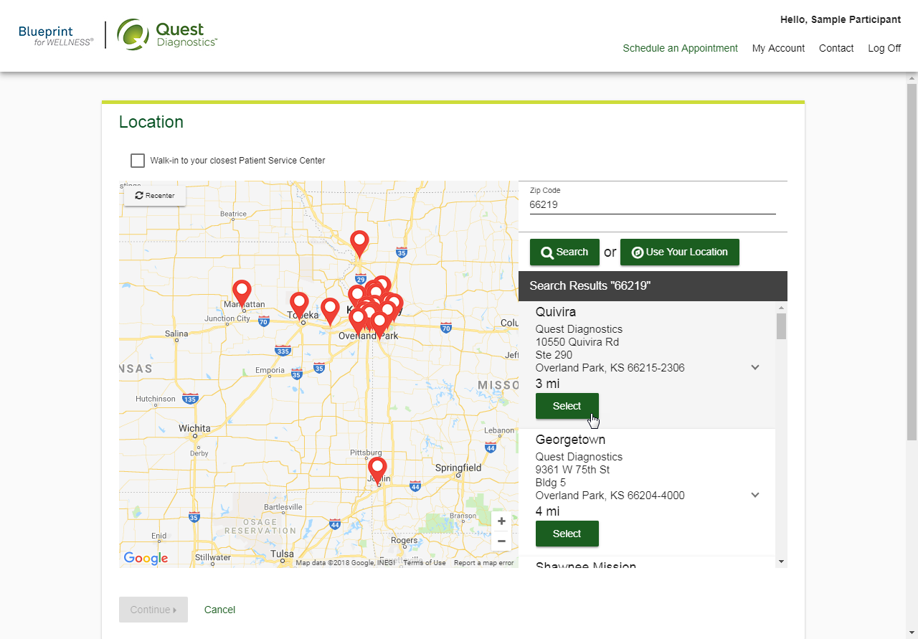
Select the Quest Diagnostics PSC location where you’d like to complete your screening
Note: To search for PSC locations in other areas than your home zip code, simply change the zip code
Select the Continue button

Slide 11
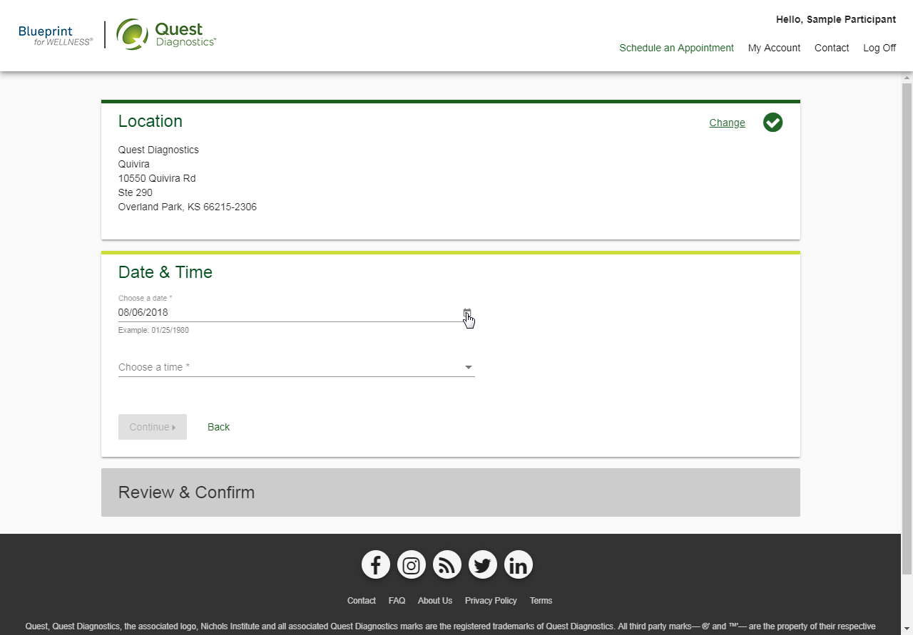
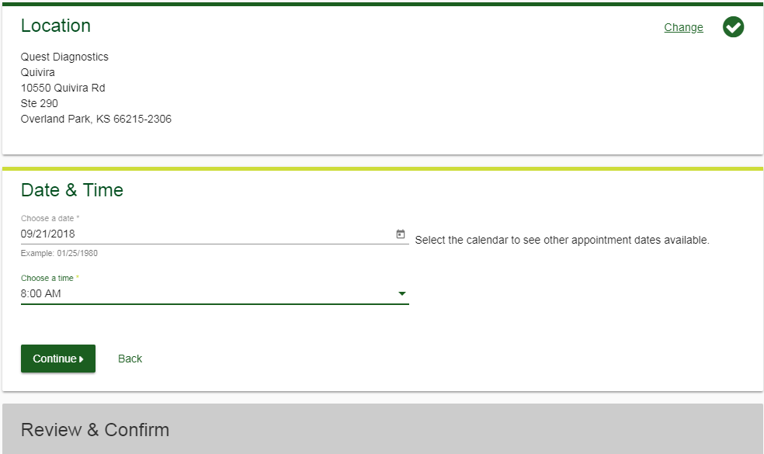
Click the calendar icon to choose a date for your screening
Even if you choose “Walk-in,” when you arrive at the PSC you may be asked to select a service time upon check-in. To guarantee availability at a time that works for you, please schedule an appointment.
Select the Time you would like to complete your screening. Note: Unavailable times will not display
Select the Continue button

Slide 12
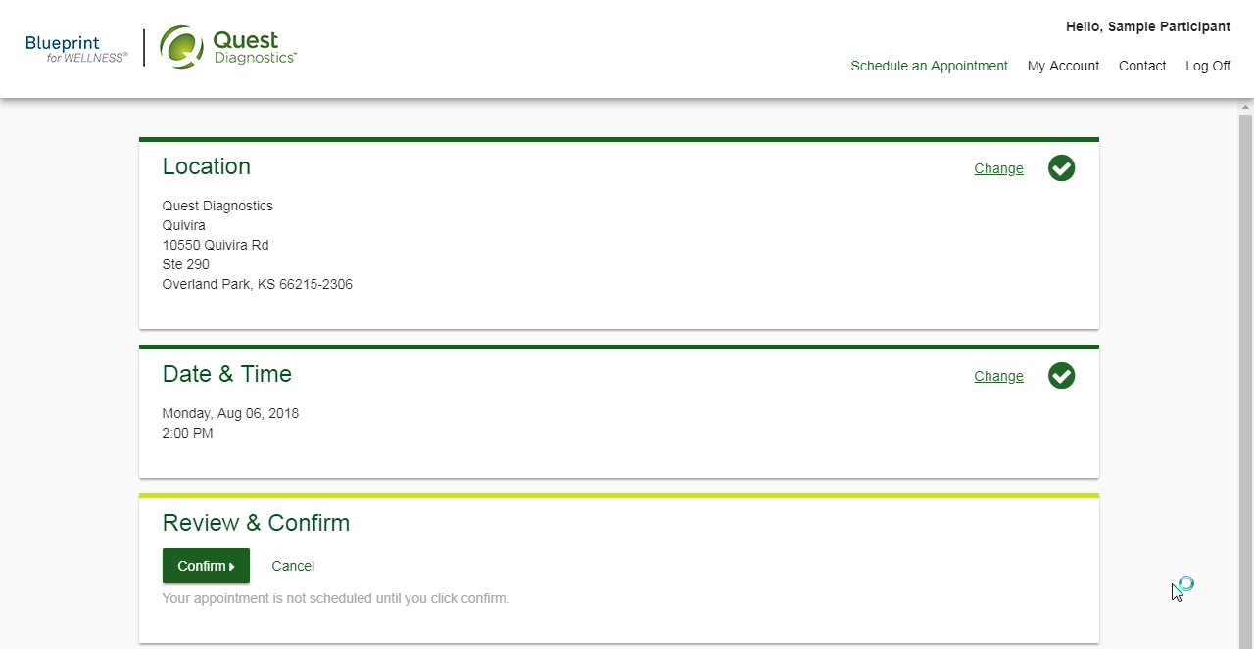
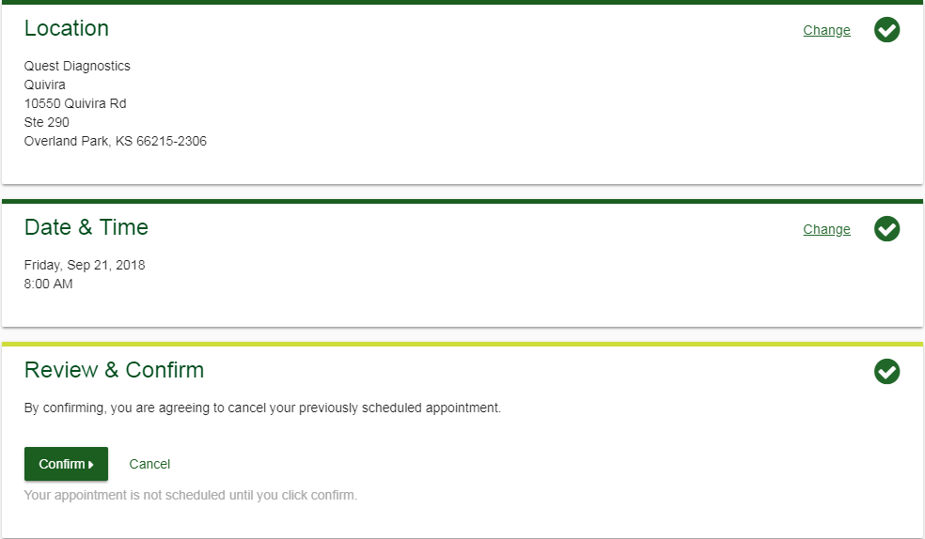
Verify that all the appointment details shown on the screen are accurate
Select the Confirm button
NOTE: Your appointment is not scheduled until you select the green Confirm button

Slide 13
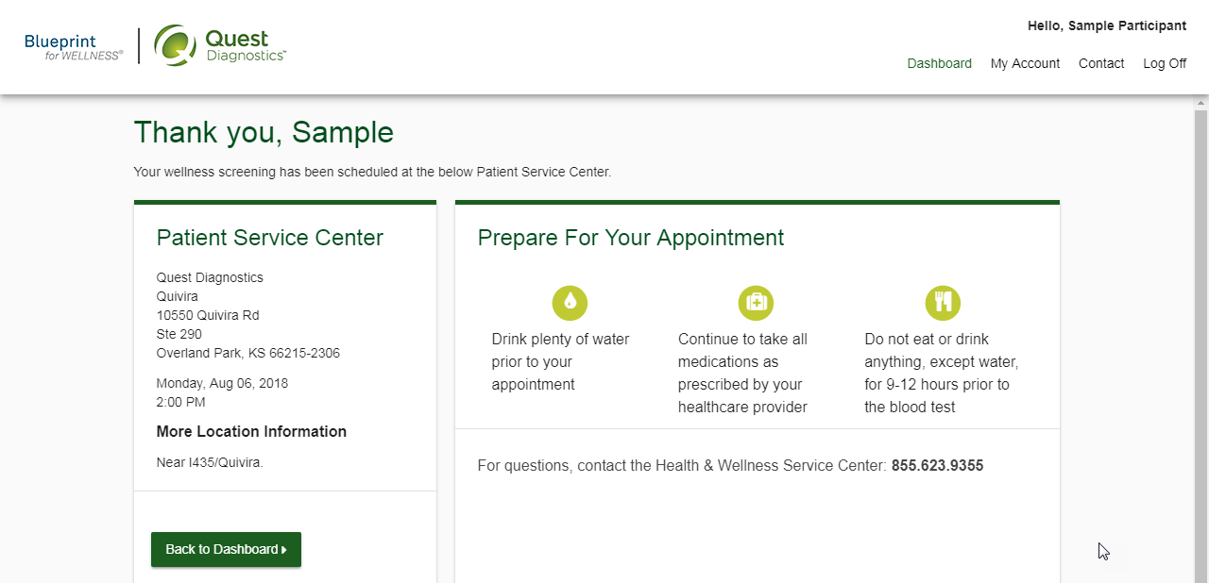
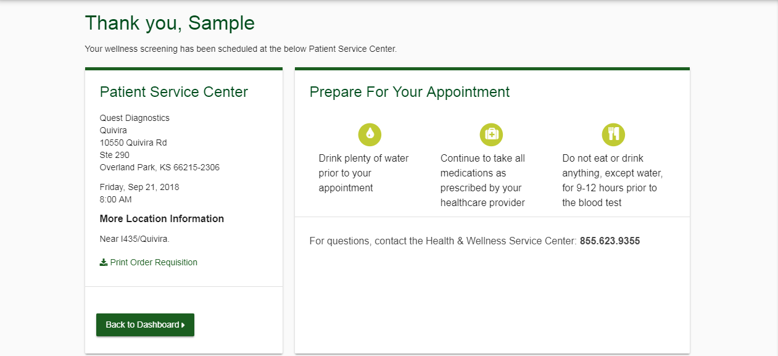
Once your appointment has been scheduled you will arrive at the Confirmation screen
You can download your Order Requisition by selecting Print Order Requisition on the left side of the screen
Select the green Back to Dashboard link to return to the dashboard

Slide 14
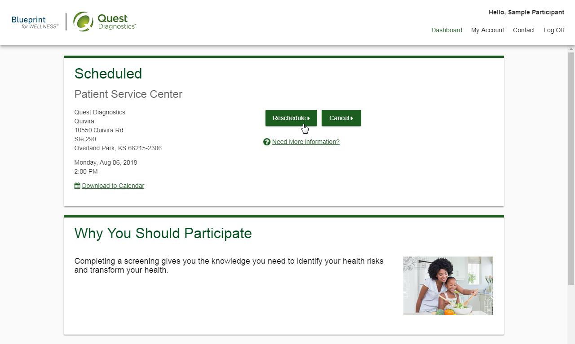
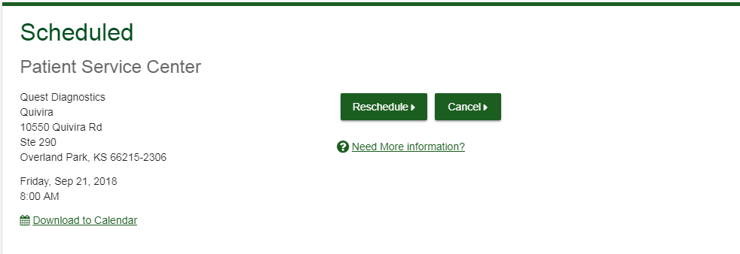
On the dashboard, you will be able to see your scheduled appointment
You can select the green Download to Calendar link to add the appointment to your calendar
If needed, you can also use the green buttons to cancel or reschedule your appointment
Selecting the Need more appointment information? link will take you back to the appointment confirmation page

Slide 15
How to schedule a screening at an on-site event
Visit My.QuestForHealth.com
If you’ve already established an account, use the Log In area to enter your username and password and select the green Log In button
If you’ve forgotten your login information, use the password link to reset your password or the username link to retrieve your username
If you’ve never registered on the site to establish an account, use the Create Account area
After logging in or registering, you will be taken to the dashboard
Please note: these screenshots are based on common browser resolution; actual screens may vary due to responsive design. If you are viewing on a tablet or smartphone, the images may look different.

Slide 16
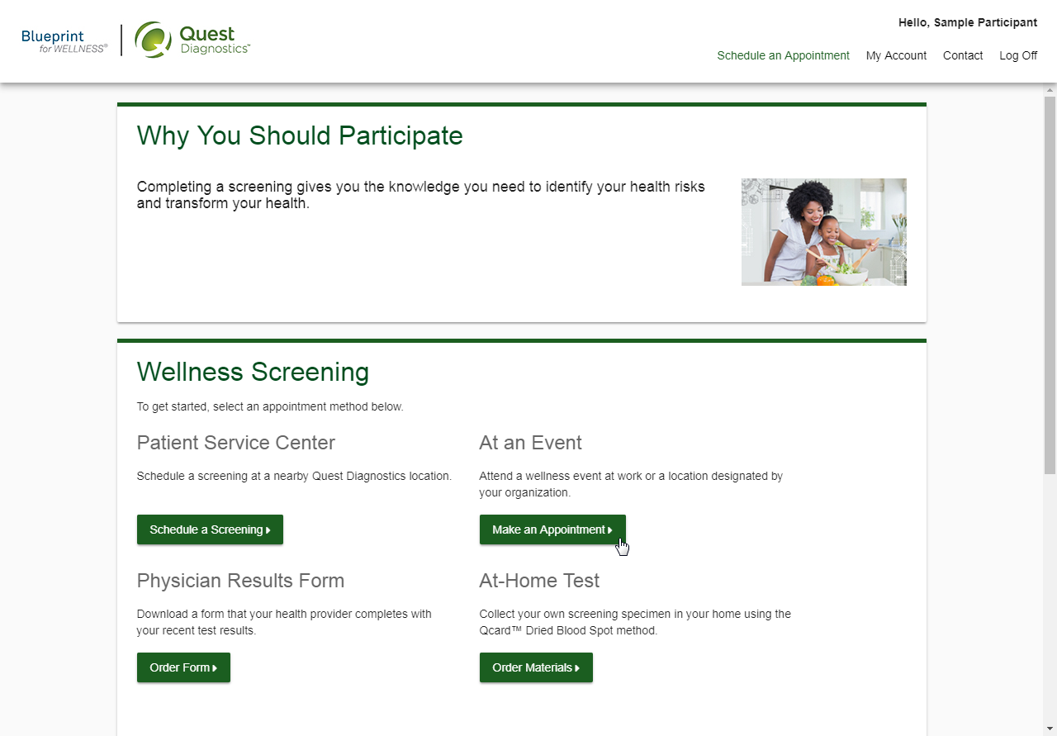
To schedule an appointment at an on-site event, in the Wellness Screening section, under At an Event, select the Make an Appointment button

Slide 17
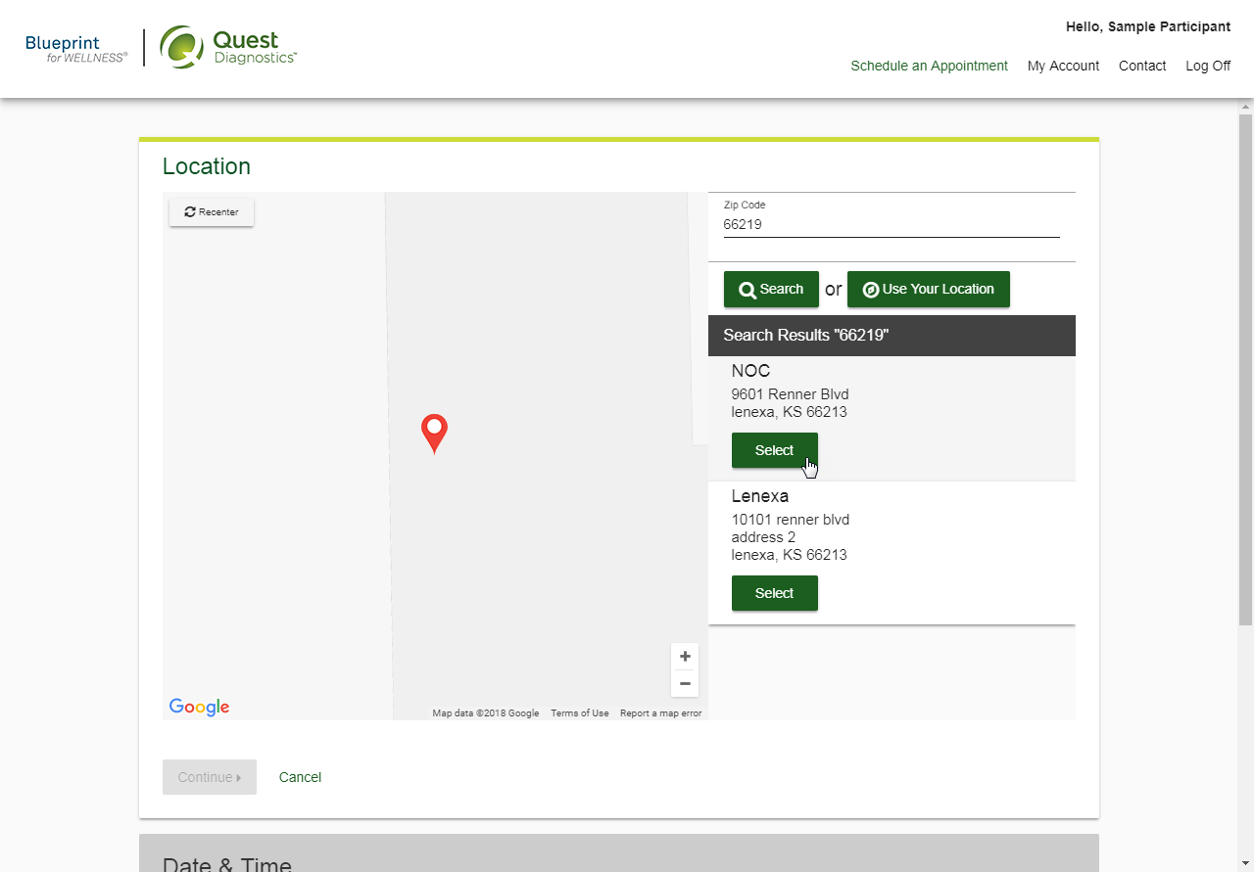
Select the on-site event location where you’d like to complete your screening
Select the Continue button

Slide 18
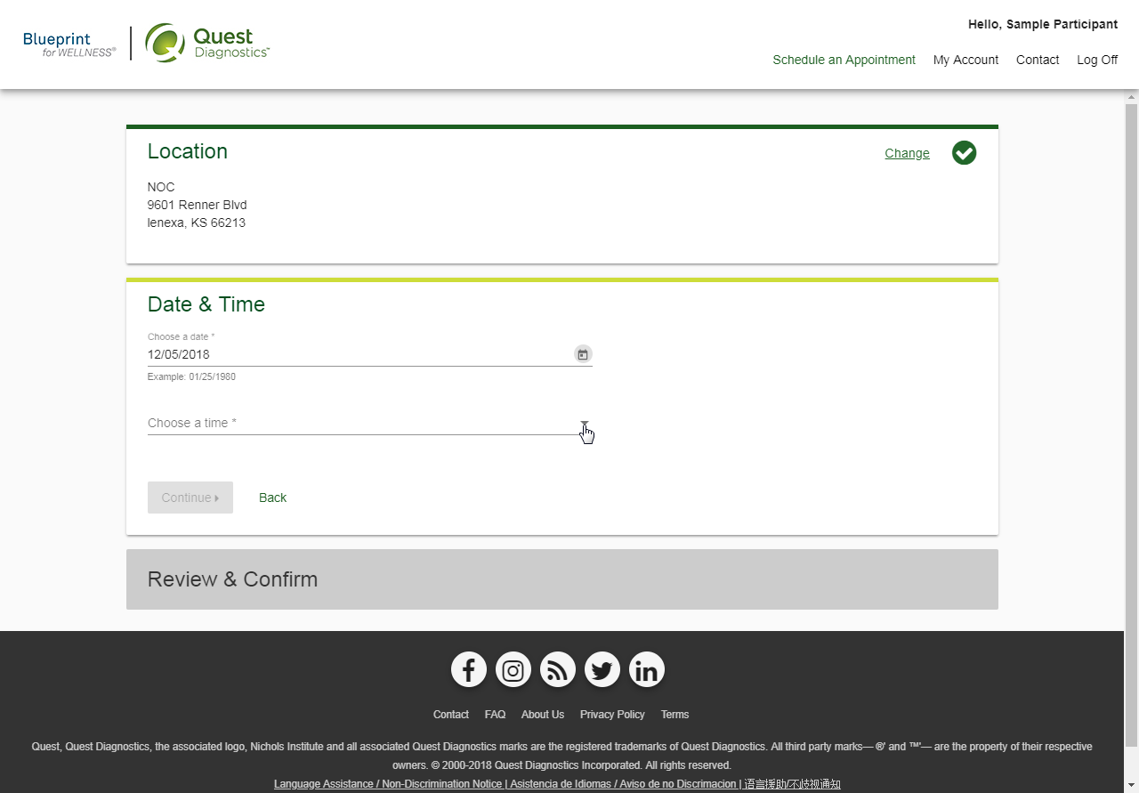
Click on the calendar icon to choose a date for your screening
Select the Time you would like to complete your screening. Note: Unavailable times will not display
Select the Continue button

Slide 19
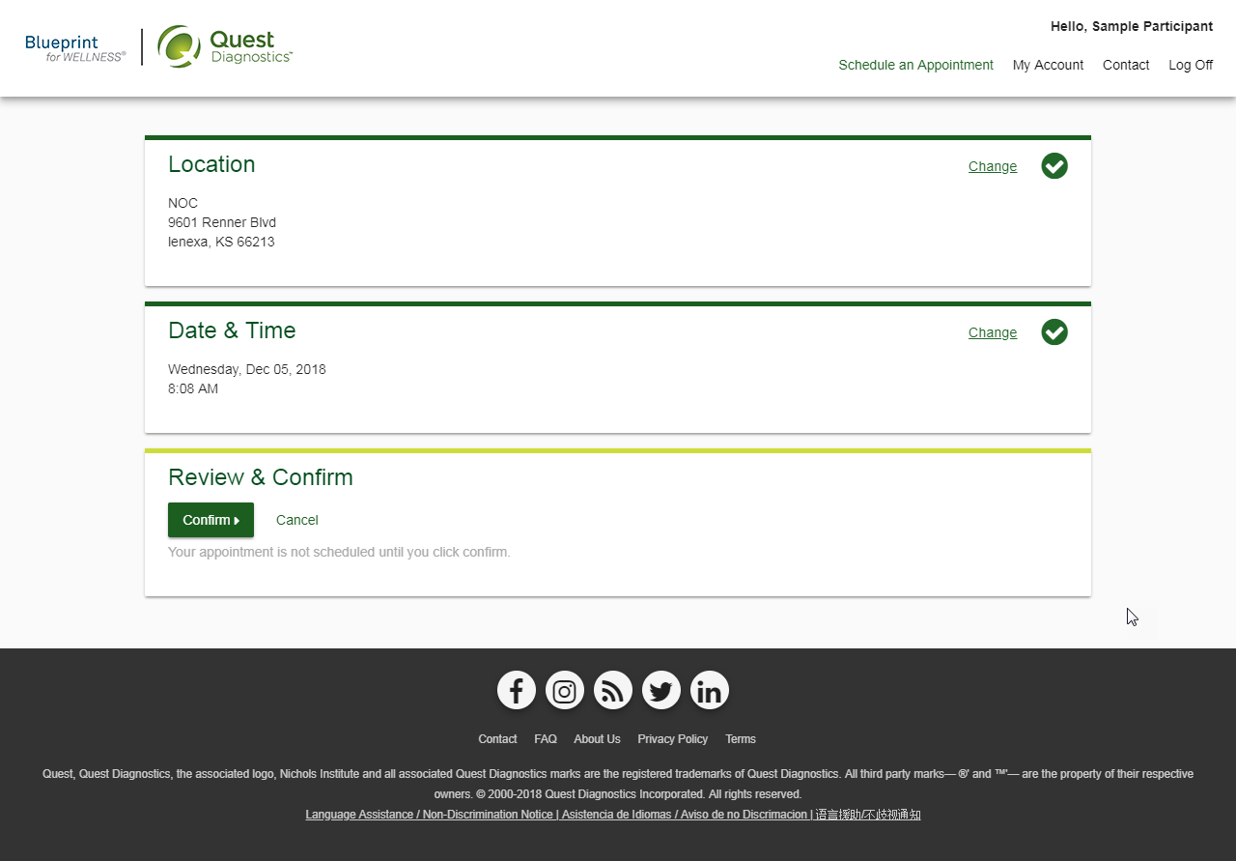
Verify that all the appointment details shown on the screen are accurate
Select the Confirm button
NOTE: Your appointment is not scheduled until you select the Confirm button

Slide 20
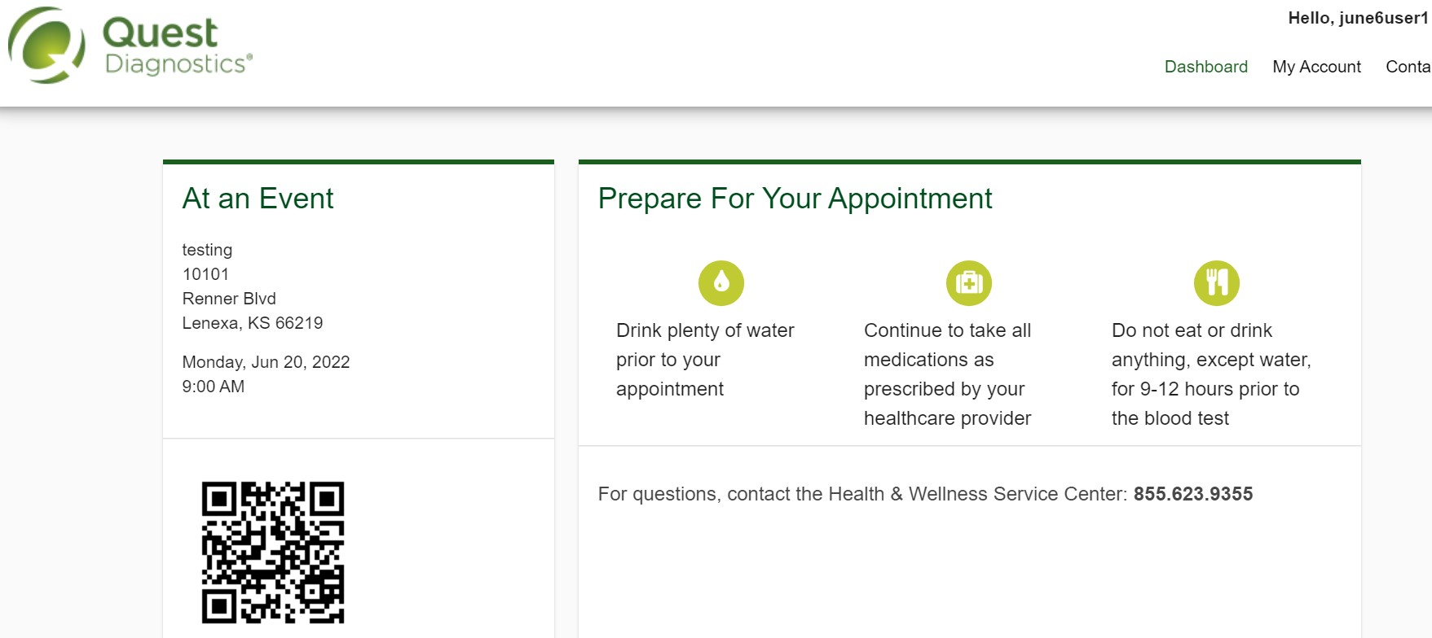
Once your appointment has been scheduled you will arrive at the Confirmation screen
Select the green Back to Dashboard link to return to the dashboard
For your convenience, you may receive a QR code upon confirmation. This code is optional to use for an expedited check-in
Please note, not all appointments generate a QR code upon confirmation. QR code not required for appointment check-in.

Slide 21
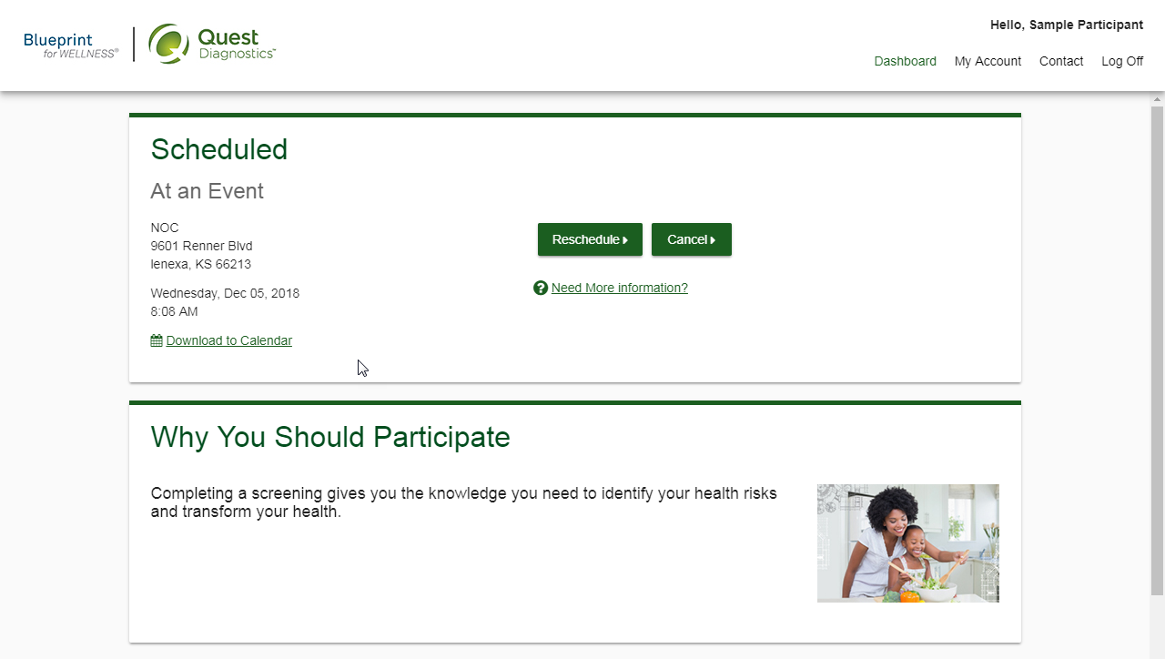
On the dashboard, you will be able to see your scheduled appointment
You can select the green Download to Calendar link to add the appointment to your calendar
If needed, you can use the green buttons to cancel or reschedule your appointment
Quest Diagnostics Incorporated and its subsidiaries (Quest) complies with applicable federal civil rights laws and does not discriminate on the basis of race, color, national origin, age, disability, or sex. ATTENTION: If you speak English, language assistance services, free of charge, are available to you. Call 1.844.698.1022. ATENCIÓN: Si habla español (Spanish), tiene a su disposición servicios gratuitos de asistencia lingüística. Llame al 1.844.698.1022. 注意：如果您使用繁體中文 (Chinese), 您可以免費獲得語言援助服務. 請致電 1.844.698.1022.
Quest, Quest Diagnostics, any associated logos, and all associated Quest Diagnostics registered or unregistered trademarks are the property of Quest Diagnostics. All third-party marks—® and ™—are the property of their respective owners. ©2023 Quest Diagnostics Incorporated. All rights reserved. 8/2023. PAR0029

